Slide 1
FAKULTAS TEKNOLOGI INFORMASI
ANALISIS TEKS PADA MEDIA SOSIAL
[KP398 – 2 SKS – S1 TEKNIK INFORMATIKA]

Slide 2
SOCIAL MEDIA NETWORK ANALYTICS
Pertemuan 13

Slide 3
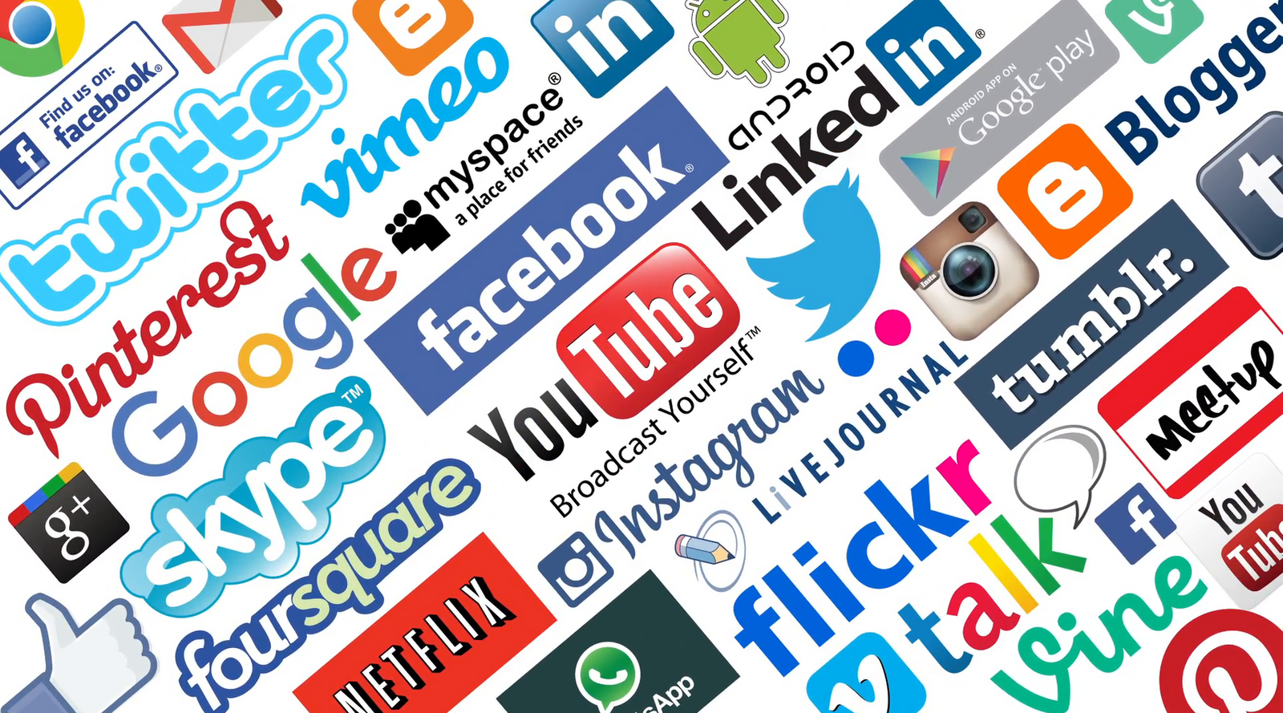
13
Analisis Teks pada Media Sosial
S1 Teknik Informatika
Social Media
NETWORK ANALYTICS
Dr. Achmad Solichin, S.Kom., M.T.I.
Universitas Budi Luhur

Slide 4
Tujuan Pembelajaran
Mahasiswa dapat memahami dan menjelaskan secara konseptual dan praktis mengenai analisis jaringan pada data media sosial (social media network analysis).

Slide 5
Social Media Network Analytics
Social network analysis (SNA) is the process of investigating social structures through the use of networks and graph theory (Otte & Rousseau, 2002). It characterizes networked structures in terms of nodes (individual actors, people, or things within the network) and the ties, edges, or links (relationships or interactions) that connect them.
Social network analysis is the science of studying and understanding social networks (Hanneman and Riddle 2005) and social networking.
Social media network analytics deals with constructing, analyzing, and understanding social media networks (Gohar F. Khan, 2015)

Slide 6
Social Media Network Analytics
The purposes of network analysis is to (Perer and Shneiderman 2008):
Understand overall network structure; for example, number of nodes, number of links, density, clustering coefficient, and diameter.
Find influential nodes and their rankings; for example, degree, betweenness, and closeness centralities.
Find important links and their rankings; for example, weight, betweenness, and centrality.
Find cohesive subgroups; for example, pinpointing communities within a network.
Investigate multiplexity; for example, analyzing comparisons between different link types, such as friends vs. enemies.

Slide 7
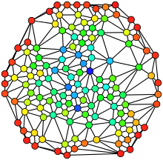
Social Network Terms: Network
A network is a group of nodes that are connected with links (Wasserman and Faust 1994).
Nodes (also known as vertices) can represent anything, including individuals, organizations, countries, computers, websites, or any other entities.
Links (also known as ties, edges, or arcs) represent the relationship among the nodes in a network

Slide 8
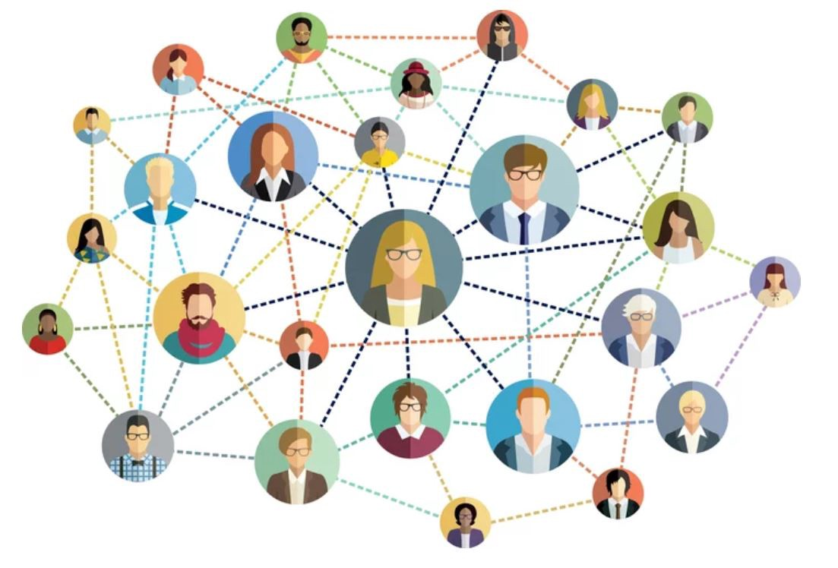
Social Network Terms: Social Network
A social network is a group of nodes and links formed by social entities where nodes can represent social entities such as people and organizations.
Links represent their relationships, such as friendship and trade relations.
Social networks can exist both in the real and online worlds.

Slide 9
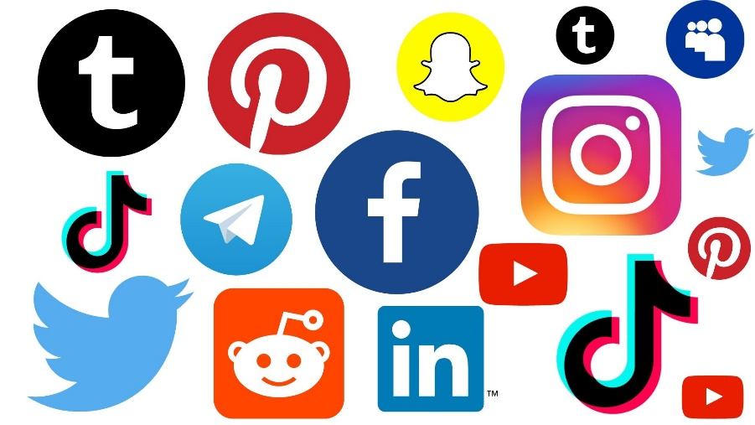
Social Network Terms: Social Network Site & Social Networking
A social network site is a special-purpose software (or social media tool) designed to facilitate the creation and maintenance of social relations.
Examples: Facebook, Twitter, Instagram, Linkedin, etc.
Social Networking is the act of forming, expanding, and maintaining social relations.

Slide 10
Social Media Network Types
Friendship Networks
Friendship networks let people maintain social ties and share content with people they closely associate with, such as family and friends
Examples: Facebook, Google+
Follow-Following Networks
In the follow-following network, users follow (or keep track of) other users of interested
Examples: Twitter

Slide 11
Social Media Network Types
Fan Networks
A fan network is formed by social media fans or supporters of someone or something, such as a product, service, person, brand, business, or other entity
Example: Facebook Fan Pages
Group Networks
Group networks are formed by people who share common interests and agendas. Most social media platforms allow the creation of groups where member can post, comment, and manage in-group activities
Examples: Twitter professional groups, Yahoo Groups, and Facebook groups

Slide 12
Social Media Network Types
Professional Networks
LinkedIn is a good example of professional networks where people manage their professional identify by creating a profile that lists their achievements, education, work history, and interests.
Example: Facebook Fan Pages
Content Networks
Content networks are formed by the content posted by social media users.
Example: Youtube
In such a network, nodes are social media content (such as videos, tags, and photos) and links can represent, for example, similarity (content belonging to the same categories that can be linked together)

Slide 13
Social Media Network Types
Dating Networks → Tinder
Coauthorship Networks → Wikipedia
Cocommenter networks → FB Status, blog post
Colike Networks → FB, Twitter, etc
Cooccurrence networks
Geo coexistence networks
Hyperlinks networks

Slide 14
Types of Networks
Based on existence
Based on direction of links
Based on mode
Based on weights

Slide 15
Types of Networks: Existence
Implicit Networks
Implicit networks do not exit by default (or are hidden) and need to be intentionally constructed with the help of dedicated tools and techniques.
Examples of such networks include keyword cooccurrence networks, cocitation networks, cocommenter networks, hyperlink networks, etc
Explicit Networks
Explicit social media networks exist by default
Examples of explicit social media networks include Facebook friendship network, Twitter follow-following networks, LinkedIn professional networks, YouTube subscribers’ network, and bloggers’ networks

Slide 16
Types of Networks: Direction
Directed Networks
A network with directed links among nodes is called a directed network Usually, a link with an arrow is drawn to show the direction of the relationship among the nodes.
For example, the Twitter following-following network is a directed network where direction of the arrow shows who is following whom.
Undirected Networks
An undirected networks, the links among the nodes do not have any direction.
A Facebook friendship network is an example of undirected network.

Slide 17
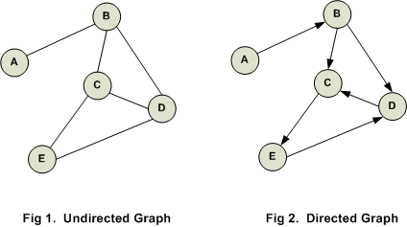
Types of Networks: Direction

Slide 18
Types of Networks: Mode
One-Mode Networks
A one-mode network is formed among a single set of nodes of the same nature.
A Facebook friendship network is an example of a onemode network where nodes (people) form network ties (friendships).
Two-Mode Networks
Two-mode networks (also known as bipartite networks) are networks with two sets of nodes of different classes (Latapy, Magnien et al. 2008). In these networks, network ties exist only between nodes belonging to different sets
Multimode Network
A multimode network is also possible where multiple heterogeneous nodes are connected together.

Slide 19
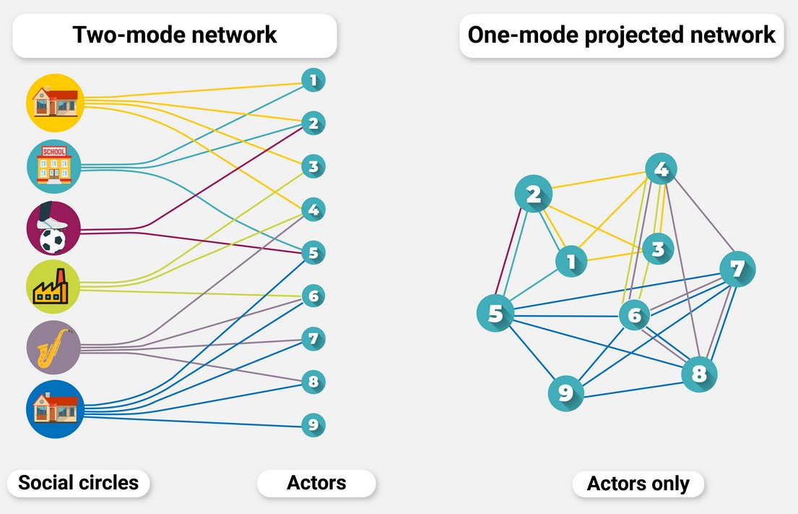
Types of Networks: Mode

Slide 20
Types of Networks: Weights
Weighted Networks
In weighted networks, the links among nodes bear certain weights to indicate the strength of association among the nodes. The link (relationship) between, for example, two Facebook friends (nodes) will be thicker if they communicate more frequently
Unweighted Networks
In unweighted networks, links among nodes does not bear weights. The links only indicate the existence of a relationship and cannot provide clues about the strength of relationship

Slide 21
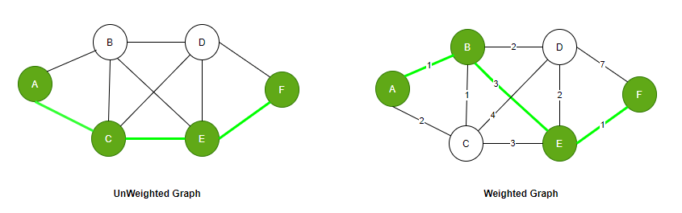
Types of Networks: Weights

Slide 22
Common Network Properties
Node Level
Network level
Degree centrality
Betweenness centrality
Eigenvector centrality
Structural holes
Clustering coefficient
Density
Diameter
Average degree
Components

Slide 23
Node-Level Properties: Degree Centrality
Degree centrality of a node in a network measures the number of links a node has to other nodes (Hanneman and Riddle 2005).
Example:
Facebook → the number friendship ties a user has.
Twitter → the number of followers a user has.
In a directed network, degree can be either in-degree or out-degree. Indegree is the number of incoming links a node in a network receives.
For example, in a Twitter network, in-degree represents the number of followers a person has. Out-degree represents that number of out links a node sends. In a Twitter network, for example, the number of people a person follows represents out-degree of a person (node).

Slide 24
Node-Level Properties: Betweenness Centrality
Betweenness centrality is related to the centrality (or position) of a node in a network. The nodes with high betweenness centrality have the ability to control or facilitate collaboration or flow of information due to their central position in the network (Liu, Bollen et al. 2005).
In a Facebook friendship network, the users who occupy the central position are better positioned to control the flow of social media content

Slide 25
Node-Level Properties: Eigenvector Centrality
Eigenvector centrality measures the importance of a node based on its connections with other important nodes in a network.
It can provide an understanding of a node’s networking ability relative to that of others (Marsden, 2008).

Slide 26
Node-Level Properties: Structural Holes
The idea of structural holes was first put forward by Burt (Burt 1992) who suggest that in a network exists when a certain node has an advantage or disadvantage of its location in a network (Hanneman and Riddle 2005)
A node that is connected to users who are themselves not directly connected has the opportunity to mediate between them and profit from this mediation (Nooy, Mrvar et al. 2005)

Slide 27
Network-Level Properties
Clustering Coefficient
The clustering coefficient of a network is the degree to which nodes in a network tend to cluster or group together
Density
The density of a network deals with a number of links in a network.
Density can be calculated as the number of links present in a network divided by the number of all possible links between pairs of nodes in a network.
A fully connected network, in which each node is connected to every other node, will have a density of 1.

Slide 28
Network-Level Properties
Components
Components of a network are the isolated sub-networks that connect within, but are disconnected between, sub-networks (Hanneman and Riddle 2005).
Diameter
The diameter of a network is the largest of all the calculated shortest path between any pair of nodes in a network (Wasserman and Faust 1994), and it can provide an idea of how long it would take for some information/ideas/message to pass through the network.
Average Degree
The average degree centrality measures the average number of links among nodes in a network

Slide 29
Network Analytics Tools
UCINET
Windows, Free for 90 days (http://sites.google.com/site/ucinetsoftware/home)
Pajek (
Windows, Free (http://mrvar.fdv.uni-lj.si/pajek/)
Netminer
Windows, Trial 14-days (http://www.netminer.com/)
Mentionapp
Web-based, Free & Premium (https://analytics.mentionmapp.com/)

Slide 30
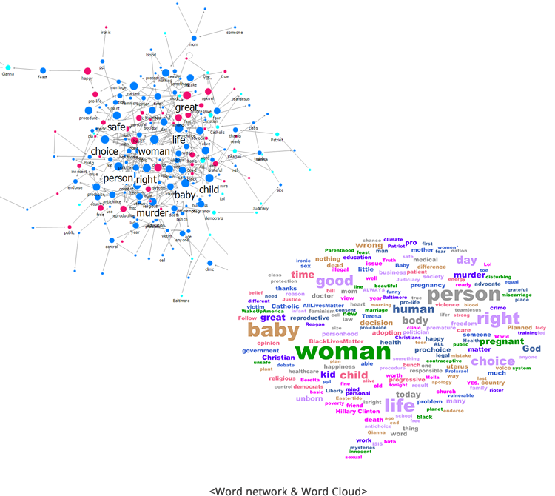
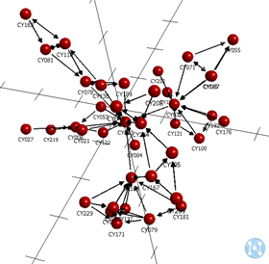
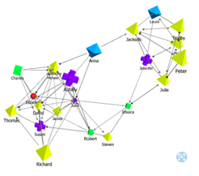
Network Analytics Tools: Netminer

Slide 31
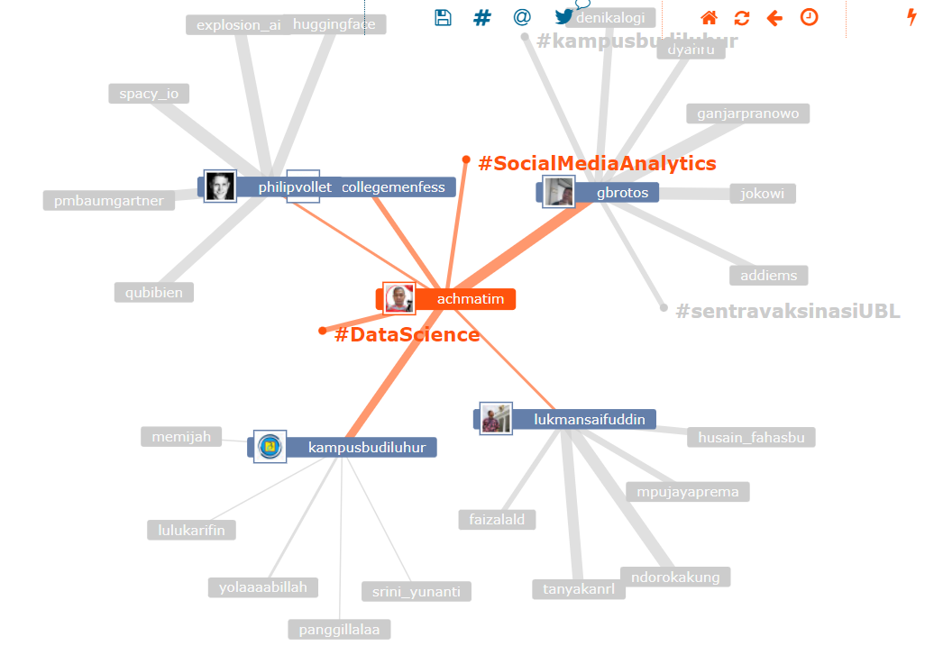
Network Analytics Tools: Mentionapp

Slide 32
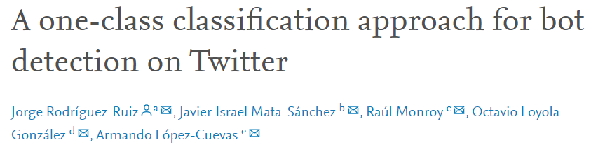
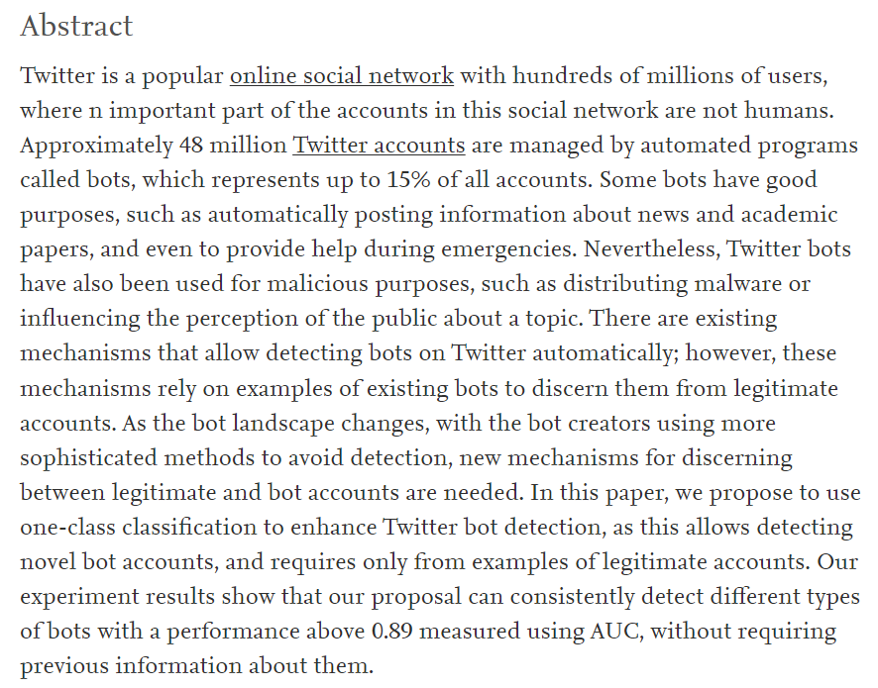
Studies in Social Networks Analysis
Highlights
A review of the methods used for Twitter Bot Detection.
A comparison of binary and multi-class classifiers for detecting unseen Twitter bots.
A novel approach for Twitter bot detection using one-class classifiers.

Slide 33
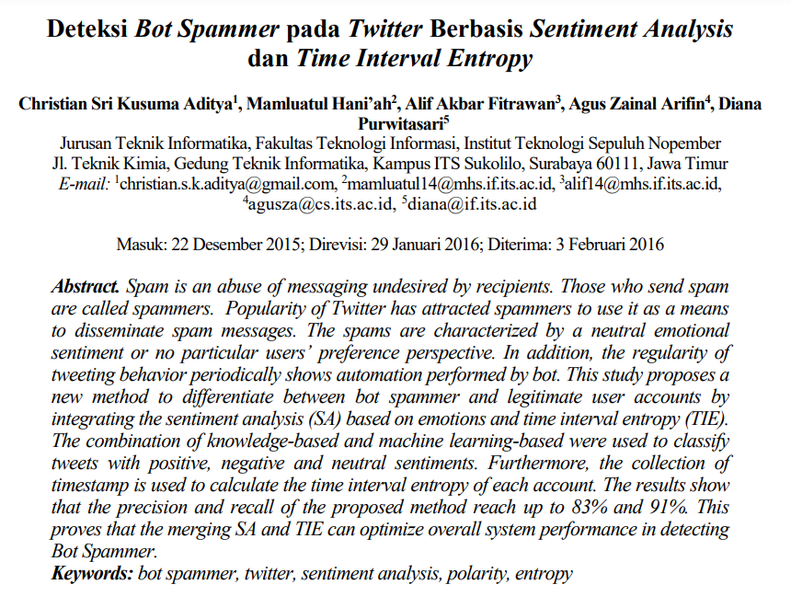
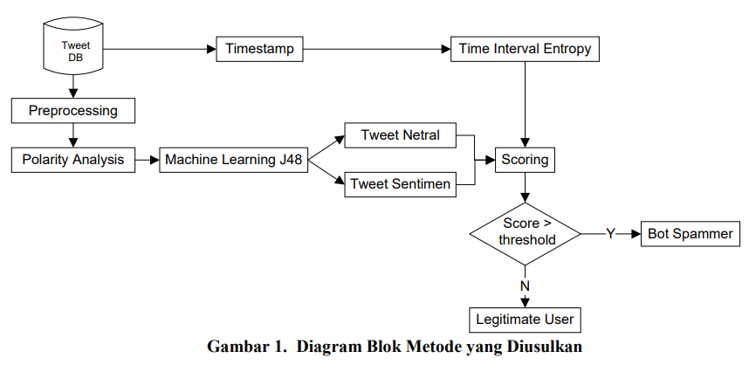
Studies in Social Networks Analysis

Slide 34
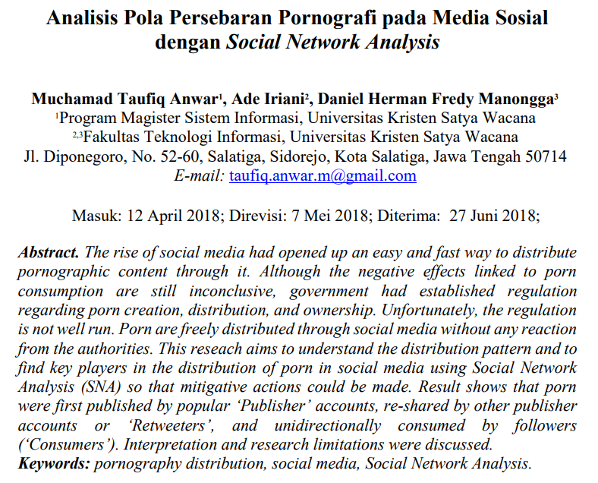
Studies in Social Networks Analysis
SNA Properties:
degree centrality (indegree dan outdegree),
betweenness centrality,
reciprocity

Slide 35





References / Books

Slide 36
Kontributor Materi
Dr. Achmad Solichin, S.Kom., M.T.I (Universitas Budi Luhur, achmad.solichin@budiluhur.ac.id) – pembuat awal.
(silahkan tambahkan nama Anda jika mengubah bahan kuliah ini)

Slide 37


Kesimpulan
TERIMA KASIH

